Slide 1

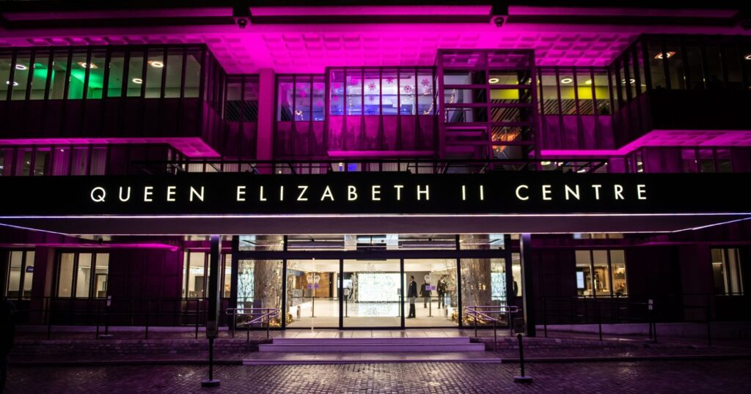

The Autumn BANN conference 16th October 2026
The British Association of Neuroscience Nurses (BANN) is delighted to join the Society of British Neurological Surgeons (SBNS) and the wider neuroscience and surgical community at the SBNS Autumn meeting 2026.
This meeting marks the 100th Anniversary of the SBNS and is taking place on 12th – 16th October 2026.
Nursing focused sessions: Friday 16th October 2026
Venue: Queen Elizabeth II Conference Centre, London (Located close to the Houses of Parliament and Westminster Abbey)
Gala Dinner: Thursday 15th October 2026 Hintze Hall in the Natural History Museum, South Kensington, London
Abstract submissions: BANN is inviting abstract submissions for the nursing programme on 16th October 2026.
Abstracts should be submitted via the SBNS website click here to be directed to the site
Registration is Now Open: Full meeting (4 days) rate £250 & day rate £125 (before 1st July) more information here

